Slide 1
CHN-R-575
Marwa Logistics Private Limited New No. 23 (Old No. 11), 2nd Floor, Linghi Chetty Street, Mannady, Chennai – 600 001 +91 44 4514 5263 / +91 94861 62277 | www.marwalogistics.com | contactus@marwalogistics.com

Slide 2
Why Choose Us?
Professionally managed logistics company engaged in providing the best logistics services.
Authorized Customs Clearing Agent (CHA) based in Chennai (Tamil Nadu) – India.
Having a strong team of professionals with great skills and knowledge, who are qualified to handle Export & Import clearance at Chennai AIR and SEA ports.
Dedicated and committed to offer excellent client services on time at a very economic rates and providing the quality service in a transparent manner.
Keeping in mind ‘Delivering Value’, we always sharing the client’s perspective and their challenges while seeking creative solutions that meet the needs of today and enable the opportunities of tomorrow.
Constantly striving for innovation by thinking beyond boundaries and discovering innovative ways to create value for our customers.

Slide 3
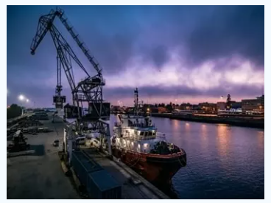
Sea Freight
Provide a complete range of Sea freight services for Export and Import
Offering by selecting the most suitable shipping arrangement from shipping companies according to the requested schedule and freight by our well experienced team of Sea freight professionals.
Offering the cost effective, time constraints, reliable, flexible and secure solutions.
Ensuring the Client’s cargo reaches its destination on time and hassle free.
Sea Freight Services
Carrier Booking
Bill of Lading & Docs
Freight Insurance / Marine Insurance
FCL / LCL, Import and Export
Customs Clearance
Transportation
Warehousing

Slide 4
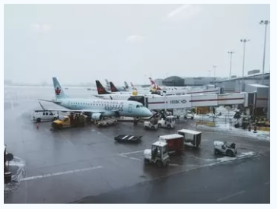
Air Freight
Provide a complete range of air logistics solutions.
Focus on to choose the best time bound and cost effective route
Support every phase of the supply chain.
Customs Clearance.
Air Freight Services
Door to door or Airport to Airport
Air Freight Import and Export Consolidation
Freight Insurance
Air Cargo Tracking
Time Bound Express Service
Deferred Competitive Air Freight Service
AWB , Documentation & Customs Clearance
Air Carrier Booking

Slide 5
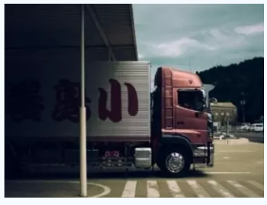
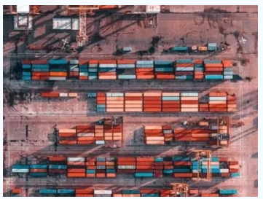
Land Transportation
Provide a complete range of over the road logistics solutions.
Constantly focus on to choose the best time bound and cost effective route and support every phase of the supply chain.
Containers and small shipments transportation from/to Port to/from Door.
Land transportation.
Freight Insurance.
Border clearance.
Customs Clearance
Authorized Customs Clearing Agent provides a complete range of in-house customs clearance services.
This service empower us to provide clients who requires a “One-Stop Solution” of freight, clearance and delivery.
Our well experienced team of dedicated, experienced and trained professionals to ensure the customs formalities are dealt efficiently resulting the smooth clearance in time.

Slide 6
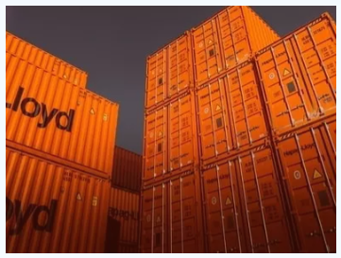
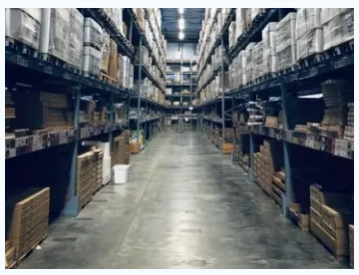
Cargo Consolidation
We Marwa Logistics, provide Cargo Consolidation services for Imports as well as Exports.
We consolidate the number of individual orders together and bundle into a single delivery, which allows for reducing the shipment cost.
Cargo Warehouse
We Marwa Logistics, our team of experts specialized in cargo handling and warehouse operations including general cargo handling, ware housing, document handling etc.

Slide 7
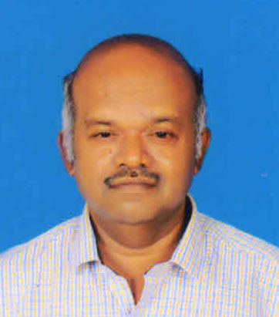
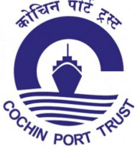
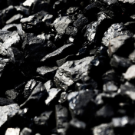
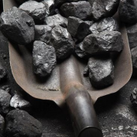
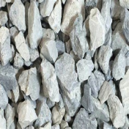
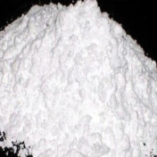
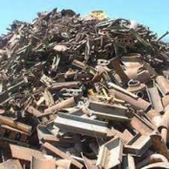
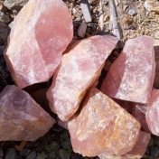
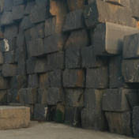
SUBRAMANIAN V, Manager, C & F
‘F’ Card Holder / Our POA
30+ Years of experience in Customs Clearance, Handled 4,000+ Shipments - Approx. 240 Million Tonnage, dealt with major ports and various types of Cargoes
Ports Dealt with
Dealt with Export & Import Cargoes
Dealt with Major Importers & Exporters

Slide 8
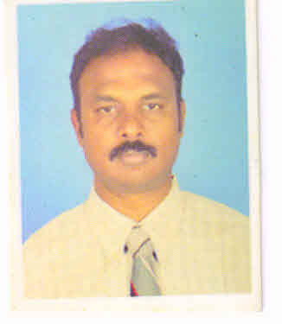
ANANDAN D, Manger Export & Import
‘G’ Card Holder
30+ Years of experience in Export and Import procedures and service, dealt with all types of Export and Import Cargoes in Chennai SEA/AIR ports.
Ports Dealt with
Specialization
Export and Import of Garments, Fabrics, Machineries, Personal Baggages in Containers, Automotive Spare Parts, MANLIFT, Bulk RoRo vessel
Arrangement of Land Transport for AIR and SEA
Arrangement of All types of vehicles for South Indian region for IMPEX
IMPEX for EUROPE and ASIA sector
Dealt with Major Importers & Exporters

